Slide 1
方舟编译器孵化器 PLCT实验室 史宁宁 2020-01-10

Slide 2
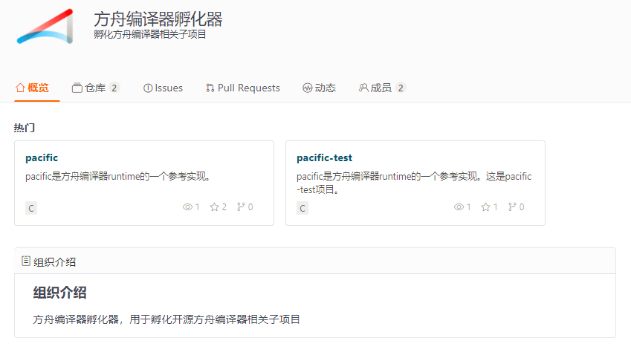
孵化方舟编译器相关子项目
方舟编译器孵化器
孵化方舟编译器相关子项目
From:
https://gitee.com/organizations/openarkcompiler-incubator

Slide 3
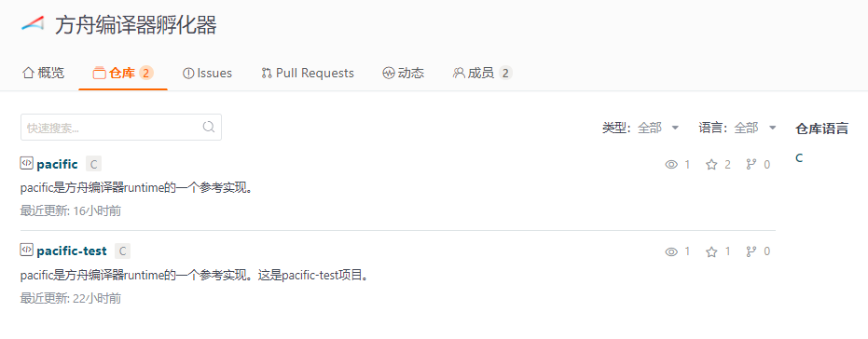
方舟编译器孵化器项目
pacific: a toy runtime for ark compiler
From:
https://gitee.com/organizations/openarkcompiler-incubator/projects

Slide 4
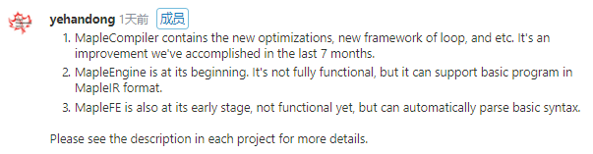
方舟编译器孵化器项目
Maple Compiler, Maple Engine, Maple FrontEnd
From:
https://gitee.com/harmonyos/OpenArkCompiler/issues/I182NY

Slide 5
求关注！求三连！

